Slide 1
Education Initiative Design Sprint |
Helping Districts Power Family-School Partnerships
June 15, 2021
Notes:
Kelsey to welcome everyone to event and present.

Slide 2
Opening Reflection
IN THE CHAT BOX, PLEASE SHARE:
Your name, district you’re from, one word that captures what family engagement meant to you this past year and one thing you’d like to learn today?
LEARNING HEROES
Notes:
Kesley to do an icebreaker with the virtual audience.

Slide 3
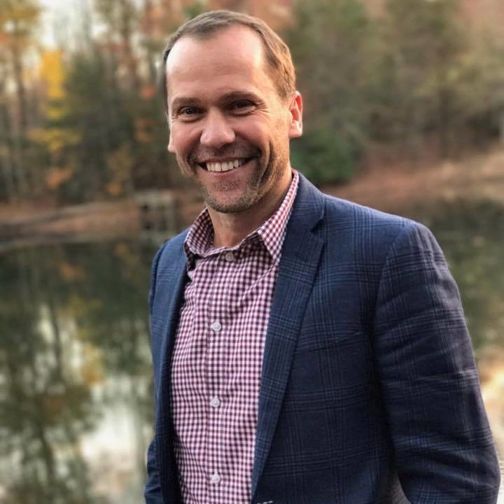
Presenters
Dr. Eyal Bergman
Co-author, Dual Capacity-Building Framework for Family-School Partnerships
David Park
Senior Vice President,
Strategy & Communication
Learning Heroes
Windy Lopez-Aflitto
VP Content and Partnerships
Learning Heroes
LEARNING HEROES
3
Notes:
Cornelia

Slide 4
MISSION
Engage parents and caregivers as their children’s
most effective education advocate by ensuring they have a complete, holistic, and accurate picture of their children’s progress and success.
VISION
Parents and caregivers as learning heroes –
advocating effectively for their children’s
academic, social, and emotional success,
driving equitable school improvement.
LEARNING HEROES
Notes:
Bibb to provide overview to mission and vision

Slide 5
Engaging With Parents Through Partners
Notes:
Can’t do it alone! Honored and humbled to do this work alongside hundreds of partners. Working collectively by building on each other’s assets instead of duplicating efforts.
Learning Heroes doesn’t primarily invest in our brand to make it a household name and vehicle for reaching parents.
Instead, we reach parents through partners they already know and trust for information about their children’s education.
Partners include – SEAs, LEAs, corporations, local and national non-profits, educator-serving organizations, parent-serving organizations, civil rights and advocacy organizations, and the media.
We use our parent mindset research in an actionable way by sharing our research with our partners!
Share research broadly in an actionable way to build capacity in the field to better communicate with parents. We engage partners in our research, as well, by finding out what they want to learn and what would be helpful to them to better understand about communicating with parents.
Create resources when we see gaps. Create tools and resources that are meant to be adapted for local, existing family engagement models.
Note – be sure to help audience see themselves reflected ON this list. (Customize it for the audience.)
A few more points:
Partnerships and Partner distribution model --
To break through to parents at scale and help build capacity in the field to communicate with parents, our approach is to create research-based communications and tools that are designed to be adapted and integrated into existing programs/models from trusted messengers working with families day in and day out. Through our local and national partnerships, we build capacity in the field to communicate with parents and reach parents with our content.
Backed by our data that parents are more likely to engage with resources when prompted by a trusted messenger over other engagement drivers, including paid media, we deliver our content through local and national organizations whom parents already know and trust and who can surround resources with ongoing supports to families for greater impact.
They embed our resources to strengthen their parent outreach and support.
To reach parents through their children’s teachers (whom we hear parents say they trust most for information about their child), we partner with teacher-serving organizations to distribute our resources, including EdModo, TNTP, the National Board for Professional Teaching Standards, TeachPlus, and Digital Promise, among others.

Slide 6
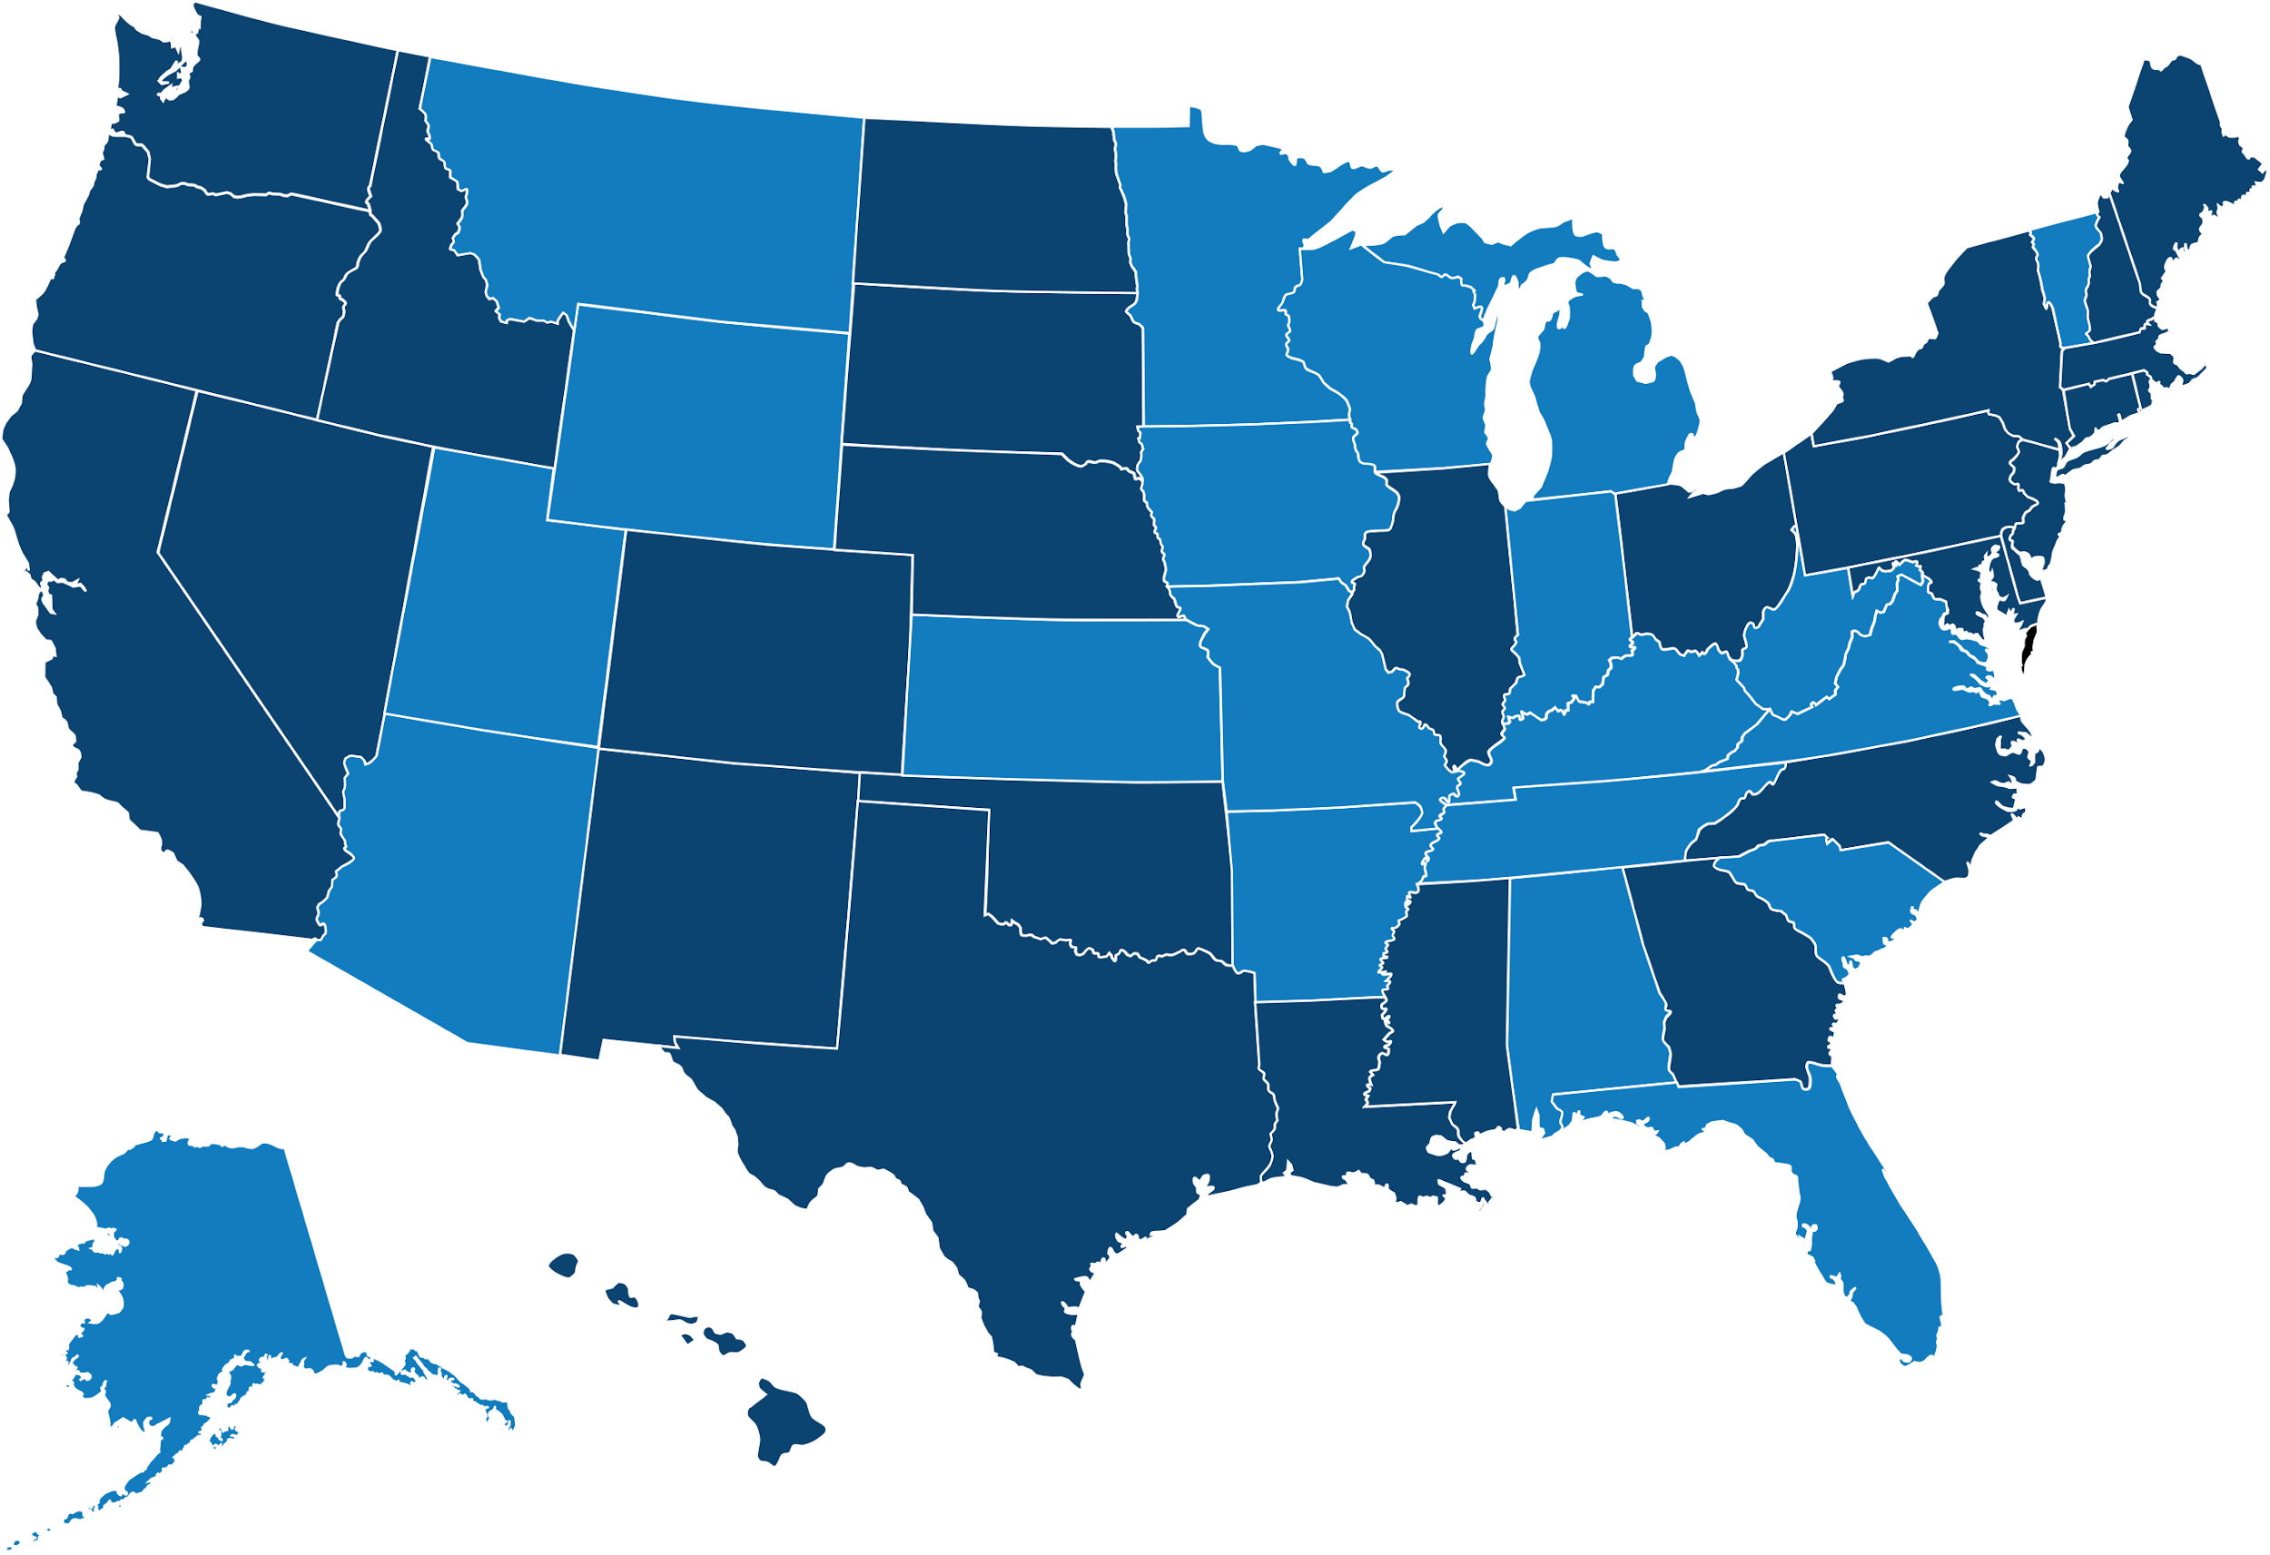
Research Base
15 national surveys
200+ qualitative sessions
All in English & Spanish
Focus on low-income parents & parents of color
Research also conducted among teachers, principals, students
Dark blue states represent locations where qualitative research was conducted by Learning Heroes
LEARNING HEROES

Slide 7
Our North Star | Parents Deserve An Accurate Picture of Student Progress
PERCEPTION
87%
Parents, regardless of race, income, and education level, believe their child is at or above grade level in reading and math.
Learning Heroes, 2016-2020
REALITY
35%
Students nationally perform at or above grade-level work.
23% Hispanic students
18% African American students
2019: 4th Grade Reading, At/Above NAEP Proficient
Notes:
And as you well know the reality is much lower among low-income students and only 18%
of Black students nationally perform at or above grade-level work.
% in math…

Slide 8
Vision of Effective Family Engagement
Dr. Eyal Bergman

Slide 9
When we talk about families…
“They
don’t…”
“They
can’t…”
“They
won’t…”

Slide 10
“The New Normal”* - a north star for family engagement
Solidarity-driven
focused (in union and fellowship)
Liberatory (free of dominance)
Equity-focused (fair and just)
*Mapp, K. L. & Bergman, E. (in press). Embracing a New Normal: Toward a More Liberatory Family Engagement Practice. Carnegie Corporation of New York.

Slide 11
Cultivating liberatory family engagement through UNLEARNING
Seminal experiences *
Collaboration with colleagues
Supportive authorizing environment
Leaders who marshal the work
* Warren, M. R. (2010). Fire in the heart: How white activists embrace racial justice. Oxford University Press.

Slide 12
High-level recommendations from “Embracing a New Normal”
Make time
Invest in professional learning (and unlearning)
Focus efforts on staff
Create senior-level positions
Integrate into equity agendas
Improve rubrics and metrics

Slide 13
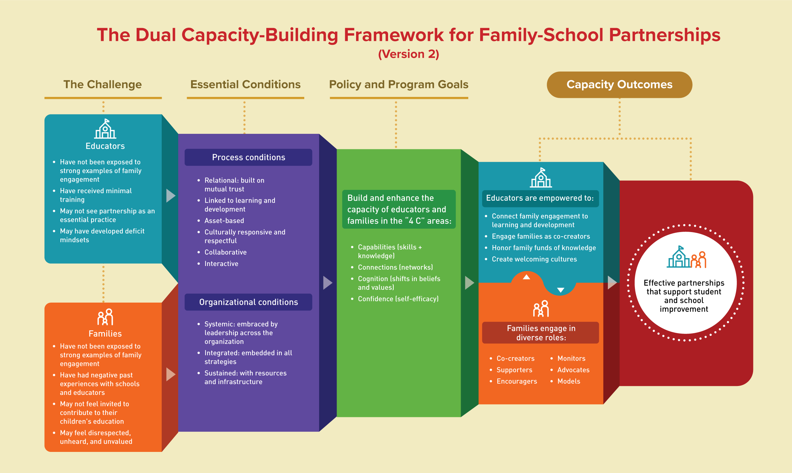

Slide 14
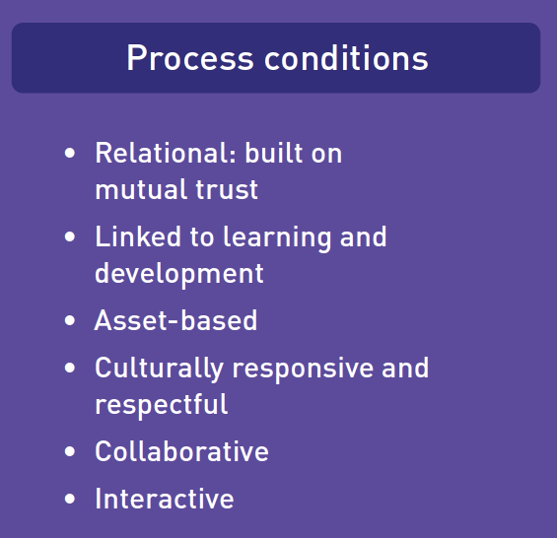

Slide 16
What We’ve Heard | Listening to Parents

Slide 17
These findings are based on two national surveys:
A Year Into the Pandemic: Parent Perceptions on Academics, State Assessment, and Education (K-12 parents), Learning Heroes and National PTA, February 2021
Out-of-School Time Programs This Summer: Paving the Way for Children to Find Passion, Purpose, and Voice (K-8 parents, educators, OST providers), Learning Heroes, April 2021
* For full surveys and methodology, visit www.bealearninghero.org/research
LEARNING HEROES

Slide 18
COVID Backdrop: A Year Like No Other
Parent and Student Perspective
Teacher/OST Provider Perspective
“Hard,” “messy,” “challenging”
Parents are feeling whiplash with instructional mode and school, and seeing academic gaps firsthand
Many feel their children are “regressing” academically, socially, and emotionally
Exhaustion, frustration, resilience
More than any other year, parent engagement is crucial to the student experience
Some parents rose to the occasion, but need was overwhelming and evolving
Worried about learning loss, chronic absenteeism, social-emotional health
“My kid used to be a superstar. Now with this homeschooling … he cannot catch up; he doesn’t want to do anything. He acts like he doesn’t know anything.” (Black Parent)
“It’s hard. We are open during the school day, getting kids connected online, coordinating. We are trying to connect with teachers and maintain a sense of normalcy.” (OST Provider)
LEARNING HEROES
Out-of-School-Time Programs This Summer | Paving the Way for Children to Find Passion, Purpose & Voice: April 2021

Slide 19
Parents Have High Aspirations & Expectations
How important is it to you personally that your child goes to college and receives a two-year or four-year college degree?
How confident are you that your child will be well prepared for entrance into and success in college upon graduation from high school?
73%
75%
African Americans: 79%
Hispanics: 77%
Whites: 71%
African Americans: 77%
Hispanics: 81%
Whites: 72%
Out-of-School-Time Programs This Summer | Paving the Way for Children to Find Passion, Purpose & Voice: April 2021
Notes:
Q59: For each of the following, please indicate how much you agree or disagree with each statement.

Slide 20
Social Connections Top the List of Parent Concerns
What are you MOST worried about right now?
-14
Missing out on social connections and friendships
Having too much screen time
Falling behind academically
Losing their motivation/interest to learn
Their emotional wellbeing
Academics vs. social connections
27% among Black Parents
Teachers: Top 3
#1 Falling behind academically: 39%
Missing social connections: 30%
Emotional wellbeing: 26%
OST Providers : Top 3
#1 Emotional wellbeing: 26%
Falling behind academically: 22%
Access to basic necessities: 20%
LEARNING HEROES
Out-of-School-Time Programs This Summer | Paving the Way for Children to Find Passion, Purpose & Voice: April 2021
Notes:
Q19: Thinking about this child, which of the following, if any, are you MOST worried about right now? Select up to 3.
Q21: Which of the following, if any, are you MOST worried about right now for your students? Select up to 3.

Slide 21
Parents Feel More Connection to Schooling, Less Confidence in their Understanding of their Child’s Achievement
Comparing this school year to a typical year, are you more/less/just as confident that you have a clear understanding of how well your child is achieving academically?
67% Agree
I am more connected with my child’s day-to-day education now than ever before
HH Income $100K+(25%)
Dads (24%)
Hispanic Parents (47%)
Moms (47%)
In-Person Learning (33%)
Notes:
Q37: Comparing this school year to a typical school year, are you more confident now, less confident now, or just as confident that you have a clear understanding of how well your child is achieving academically?
Q40: For each of the following, please indicate how much you agree or disagree with each statement.
[A: I am more connected with my child’s day-to-day education now than ever before]
[B: I am more connected with my child’s teacher(s) now than ever before]

Slide 22
Strategies & Tools To Connect With Parents

Slide 23
1
Build trust – Make a positive, personal connection with every family
2
Help families understand how well their child is performing
3
Partner with families to co-create learning plans
LEARNING HEROES
23

Slide 24
1. Build Trust—Example Strategies
Welcoming Calls/Virtual Visits—Make these during the first weeks of school to help build trust. Share a bit about you and ask parents to share their child’s interests, strengths, areas for support. Ask parents what’s the best way to stay in touch.
Good News Email/Text—Send a piece of “good news” to each family via email or text in the first weeks following the welcoming call.
Feedback Loops to Address Concerns and Elicit Ideas—Use existing communication platforms to ask families what they need most from you and the school right now. Don’t shy away from their feedback and questions, even the tough ones!

Slide 25
2. Help families understand how their child is performing Example Strategies
Share Diagnostic/Benchmark Data with Parents—Use visuals (simple graphs/charts) to help illustrate performance against benchmarks (STAR, iReady & MAP Growth). Explain what the data means and how you will use the information to help their child.
Avoid Edu-Jargon—Keep explanations concrete and actionable. Provide examples to make it real.
Provide Tools that Show Progress with Key Skills—The Readiness Check is a digital tool that helps parents see how their child has learned key skills needed for success this year.

Slide 26
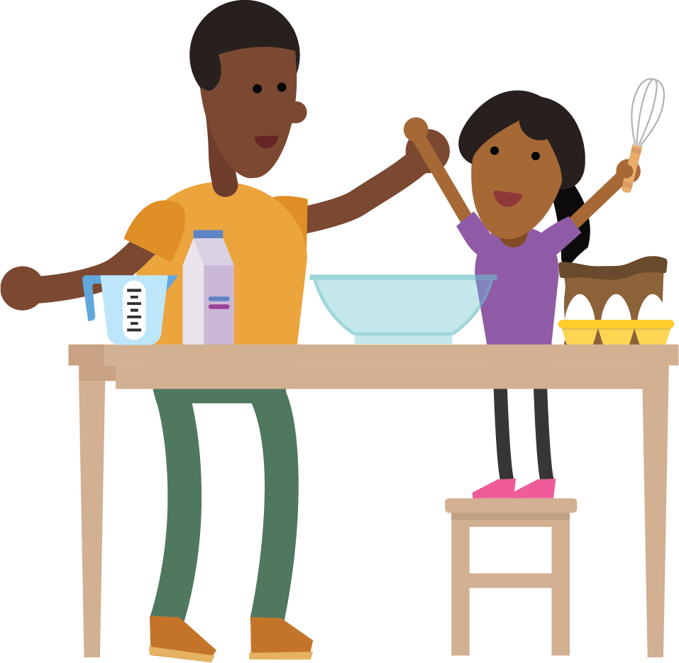
3. Partner with families to co-create learning plans Example Strategies
Co-Create a Plan focused on Key Skills—”Do Less to Do More”. Share 3 main skills in reading and math and 3 strategies and resources to support learning at home.
Start a Family Learning Lab—Provide open time for families to learn together and build community. Invite parents to identify the topics/skills/themes and co-host in partnership with other school staff (e.g. counselors, psychologists, assistant principals, etc.)
Connect Parents to Relevant Resources—e.g. community organizations, tutoring, social/emotional supports so parents know where and how to get help.

Slide 27
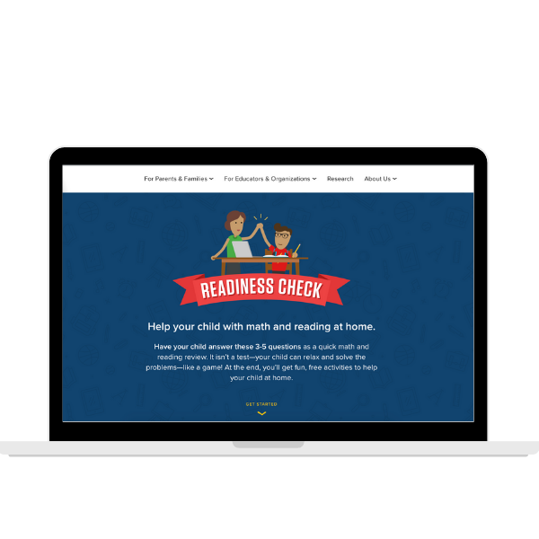
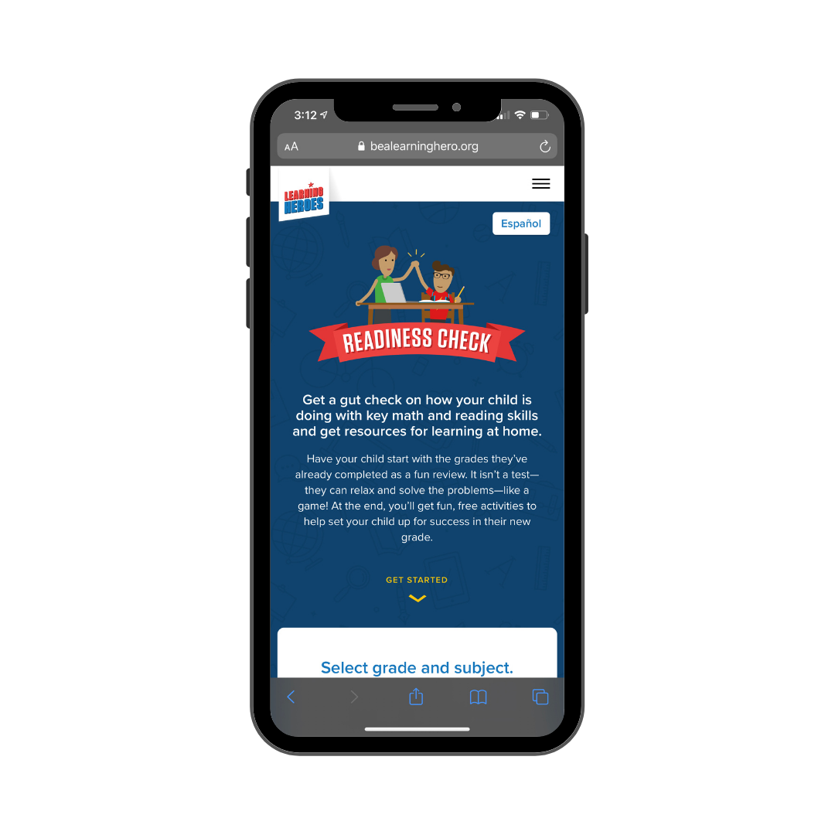
The Readiness Check | Giving Parents a Gut Check
K-8 students answer 3-5 fun, short questions in math and reading and parents see how they have progressed with end of year skills needed for next year.
Connects to skill-specific, free, easy-to-use activities & resources
Mobile-friendly and built to support ELLs (English/Spanish)
Find this tool at ReadinessCheck.org
LEARNING HEROES
Notes:
Windy to introduce the readiness check.
Visual Example of a tool that helps parents see how their child is progressing and helps them support at home.

Slide 28
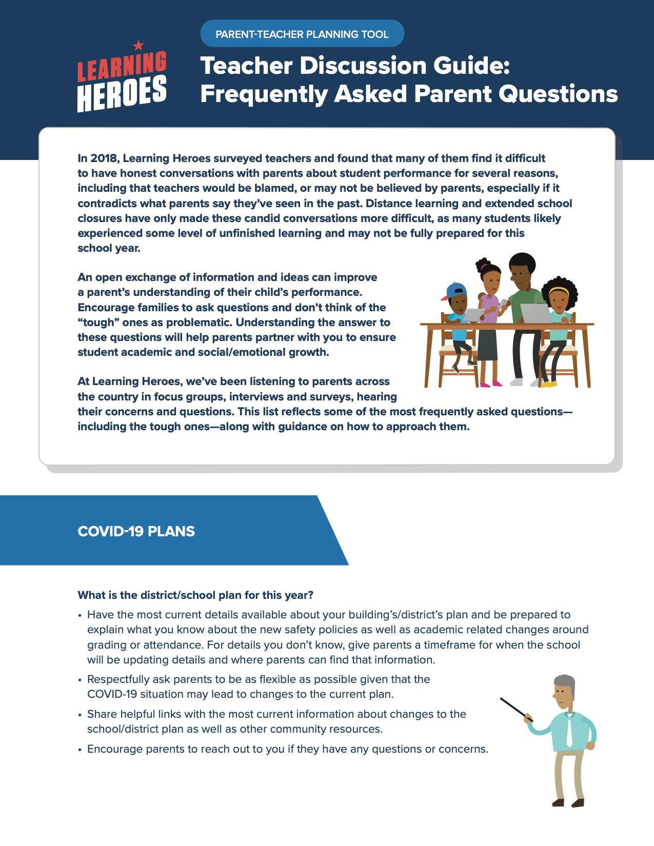
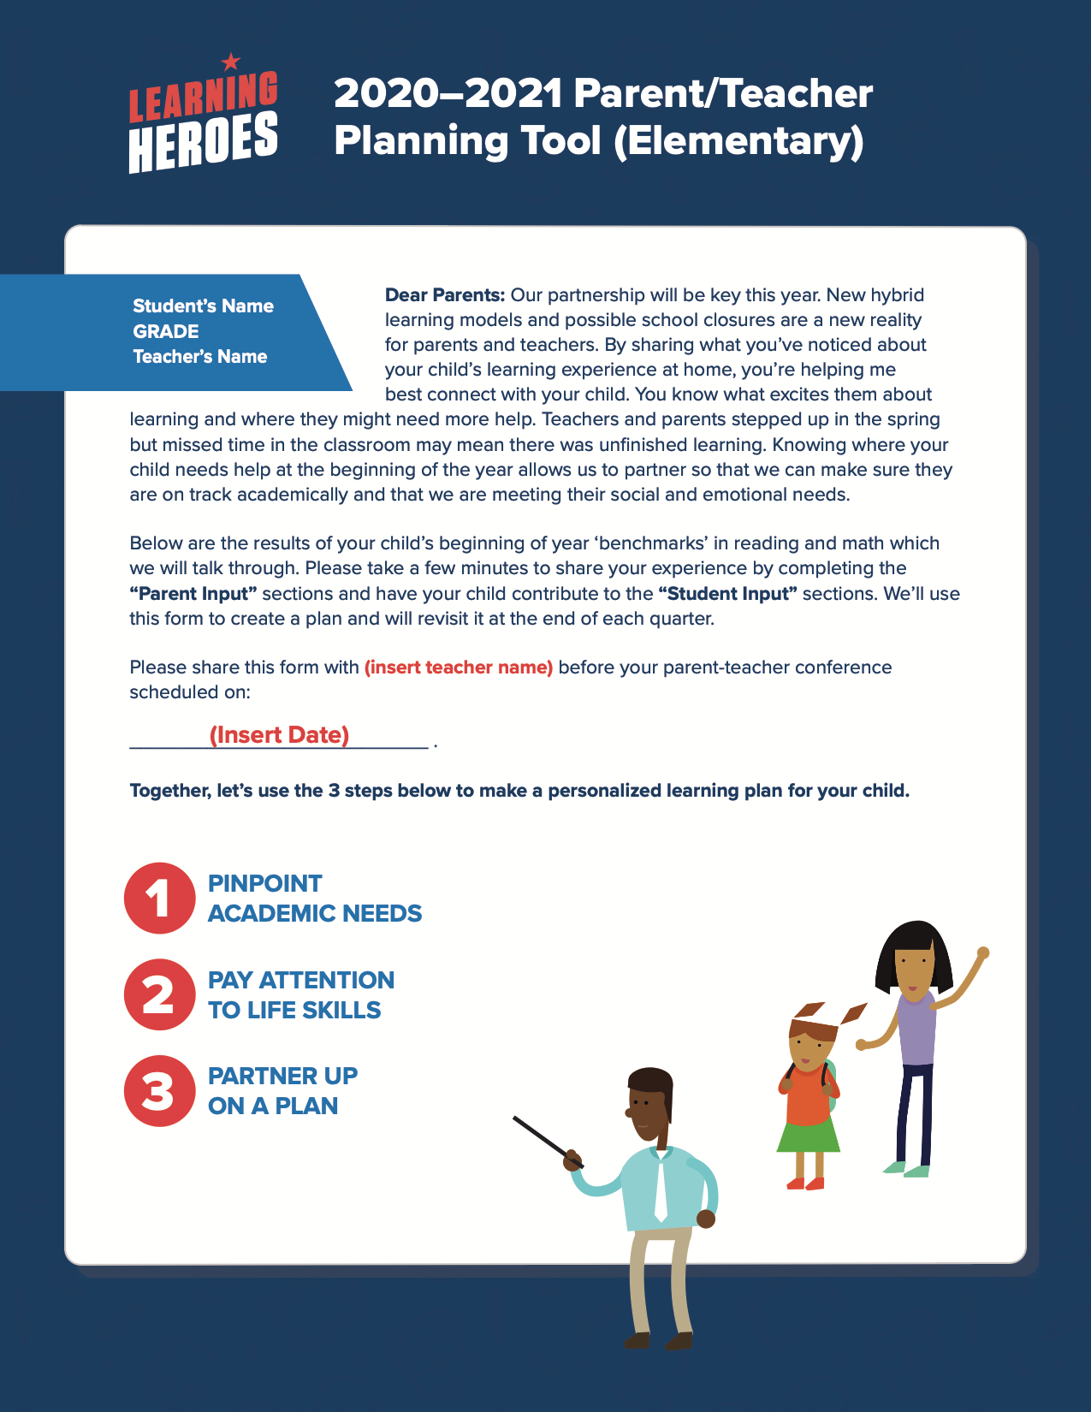
Putting the Research into Action: A Parent Teacher Planning Tool
Notes:
Visual example of the parent teacher planning tool that helps teachers share benchmark data with families and the Discussion Guide helps teachers answer parent questions.

Slide 29
Q&A
USING THE Q&A BOX:
Do you have any questions for our team?
LEARNING HEROES
Notes:
Kelsey to verbally ask of any one has questions while it’s also asked in the chat.
Close with Music

Slide 30
Putting Insights Into Action
USING THE Q&A BOX:
What is one thing you learned that you may incorporate into your District’s plan?
LEARNING HEROES
Notes:
Kelsey to verbally ask of any one has questions while it’s also asked in the chat.
Close with Music

Slide 31
Thank you!
Contact
David Park
Senior Vice President, Learning Heroes
dpark@learningheroes.org
For more information, visit our website BeaLearningHero.org
Like us on Facebook:/Bealearninghero
Follow us on Twitter:@bealearninghero
Notes:
Kelsey to end presentation and share more ways everyone can get in touch with us and access our resources.

